Slide 1

NYPD ARREST Year to Date (2022)
DATA ANALYSIS
BY NEIL ANGELO MARTINEZ
Notes:
Good day everyone! My name is Neil Angelo Martinez and I’m here to present to you my data analysis project: NYPD Arrest 2022 from Q1 to Q3

Slide 2
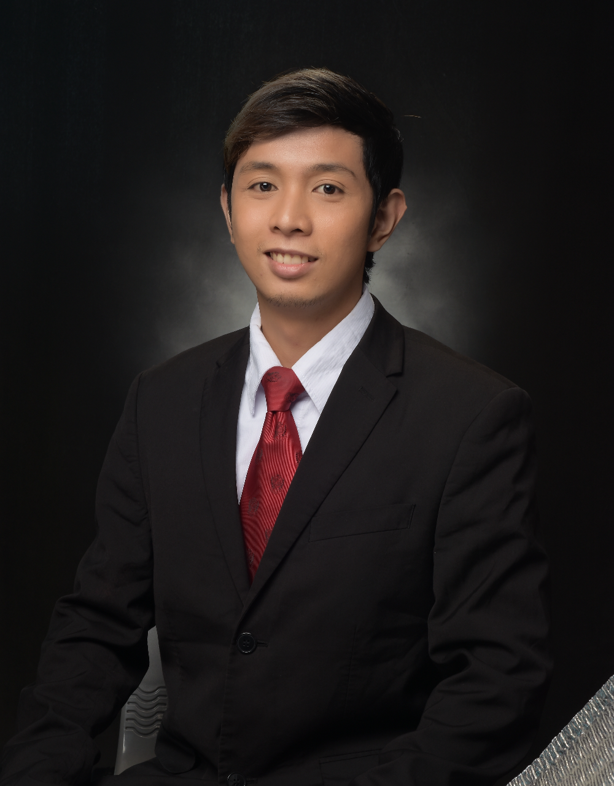
ABOUT ME
As an aspiring data analyst with a strong desire to learn and grow, I am excited to bring my passion and dedication to the field. I am currently enrolled in Refocus, the top data analytics boot camp in the Philippines, where I have gained a solid foundation in tools such as Excel, SQL, Power BI, and Python.
Notes:
Just a little something about me. I’m an aspiring data analyst excited to bring my passion and dedication to the field. I just finished the Core Track of Data Analytics at Refocus digital academy: the Top data analytics boot camp in the Philippines right now.

Slide 3


INTRODUCTION
This project aims to analyze and recognize patterns and trends in New York City police enforcement activity as represented in statistics on arrests made by the NYPD.
The information comprises the type of crime, the location and date of enforcement, and perpetrator
demographics. By examining this data, it is intended to obtain insight into the nature of police activity in the city and how it may change depending on criteria.

Slide 4

DATA SOURCES
The data for this project was collected from the New York City Police Department's NYPD Arrest Data (Year to Date) dataset in NYC Open Data website.
The main tool that is used for data analysis is Power BI. The NYPD Arrest Data (Year to Date) dataset needed to be cleaned and processed before analysis could begin.

Slide 5
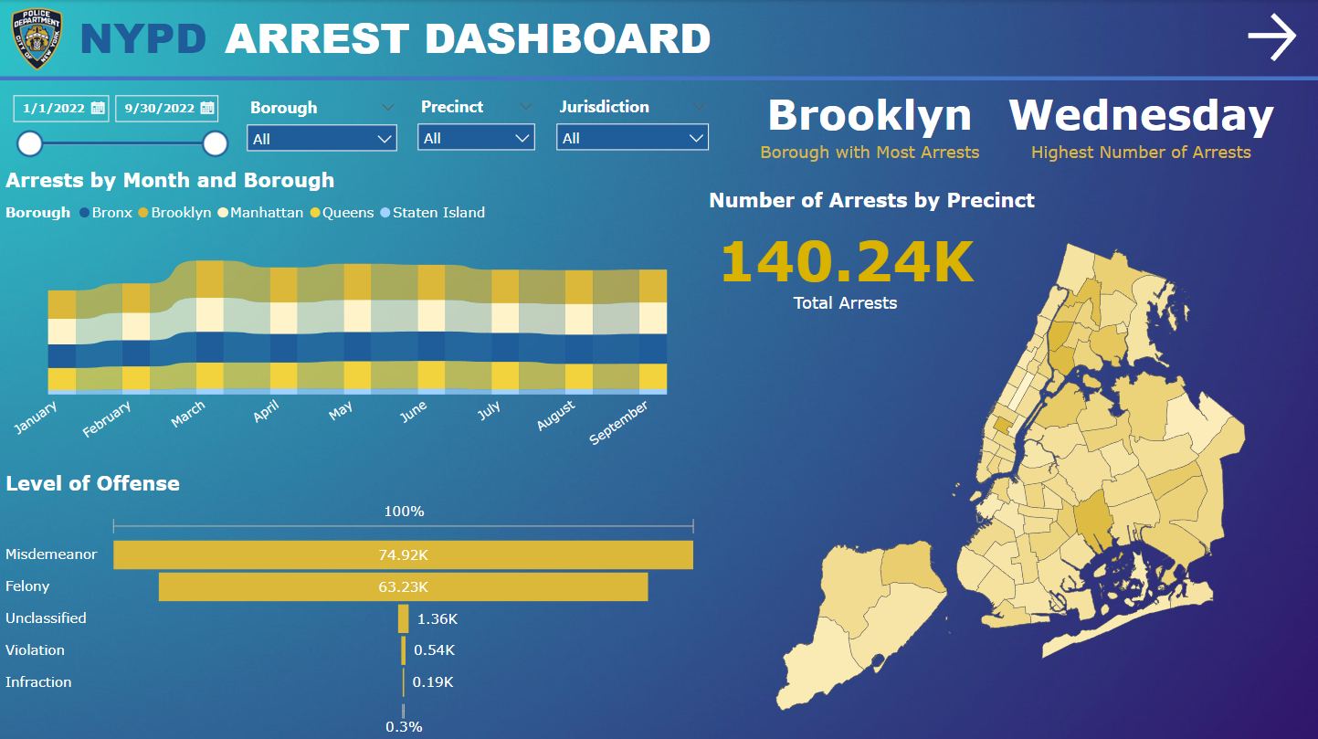
CTRL + Click on the picture to view the Power BI Dashboard

Slide 6
INSIGHTS
Brooklyn has the largest number of arrests among New York City's five boroughs during the first three quarters of 2022, with a total of 38,064 arrests.
Manhattan had the second largest number of arrests, with 34,580, Bronx (32,307), Queens (29,038), and Staten Island (6,247).
There could be a variety of reasons why some boroughs had higher arrest rates than others. It might be brought on by factors like population density, socio-economic status, the presence of various businesses or industries, or the performance of local law enforcement.

Slide 7
INSIGHTS
Misdemeanors appear to have accounted for the majority of the 74,915 arrests made in New York City during the first three quarters of 2022. Although misdemeanors generally are less serious than felonies, they can still result in serious penalties including fines and jail time.
With 63,227 arrests, felonies had the second largest number of arrests. Felonies are more serious offenses that can result in longer jail sentences and harsher punishments.

Slide 8
INSIGHTS
Black people accounted for the race in New York City with the highest number of arrests during the first three quarters of 2022, with a total of 69,531. Also, 82.5% of perps arrested are male. With 80,873 arrests, the age group of 25 to 44 had the most arrests. The two most common offenses were assault and petit larceny/petty theft.

Slide 9
RECOMMENDATION
It would be helpful for police departments and city officials to think about implementing strategies into action that address any potential causes of high arrest rates for specific offenses, such as addressing underlying social and economic factors that may contribute to crime, enhancing the efficiency of law enforcement efforts, and allocating more funds for crime prevention and intervention programs.
Additionally, it would be crucial to keep an eye on arrest statistics and other crime data to spot any changes or patterns over time and assess the success of any applied strategies.

Slide 10

DID YOU KNOW?
The 99th precinct in the TV show Brooklyn Nine-Nine is not real. What is seen on the show is Brooklyn's 78th precinct, located at the corner of Sixth Avenue and Bergen Street near the Barclays Center. Most of the show, however, is shot on a sound stage in California.

Slide 11



THANK YOU
Do you have any questions?
neilangelomartinez@gmail.com
+63 927 402 1199
bit.ly/neilmartinez
Notes:
That’s everything, I hope you liked the presentation. You can check out my portfolio website to see my other projects. I also have Medium where I write my blogs. Reach out to me via email if you have any concerns. Thank you and have a good day!

